Slide 1

IN THE NAME OF ALLAH, THE MOST GRACIOUS, THE MOST MERCIFUL

Slide 2


Innovative wearable robotics for enhancing lower limb mobility and function.
Project Members
Mubashar Aslam | FA21-BEE-002
Muhammad Aamir | FA21-BEE-029
Abdullah Khan | FA21-BEE-005
Supervised By : | Sir Qazi Zia | Co-Supervised By : | Sir Yasir Muhammad & Sir Aurangzeb
CUI, Attock
FYP- Presentation

Slide 3
Outlines
Introduction
Problem statement
Objectives
Block diagram of the proposed solution
Flowchart
Benefits to the society
UN’s sustainable development goals
Time line
References
Literature Review
Modern tools
Individual Contribution of each group member
CUI, Attock
FYP-Innovative wearable robotics for enhancing lower limb mobility and function.

Slide 4
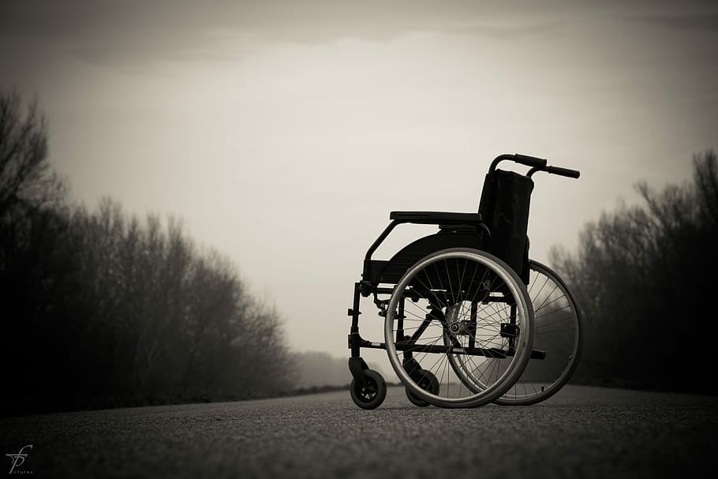
Introduction
Every day, countless people face the challenges of limited mobility due to conditions such as spinal cord injuries, muscular dystrophy, or stroke.
One of the essential measures to improve spinal cord injuries medical care and rehabilitation services is to provide assistive devices to enable spinal cord injuries patients to perform their daily life activities.
Hybrid Assistive Limb integrates task-specific programming and human movement understanding for intuitive and supportive assistance in daily activities.
.
Figure 1: A wheelchair
CUI, Attock
FYP-Innovative wearable robotics for enhancing lower limb mobility and function.

Slide 5
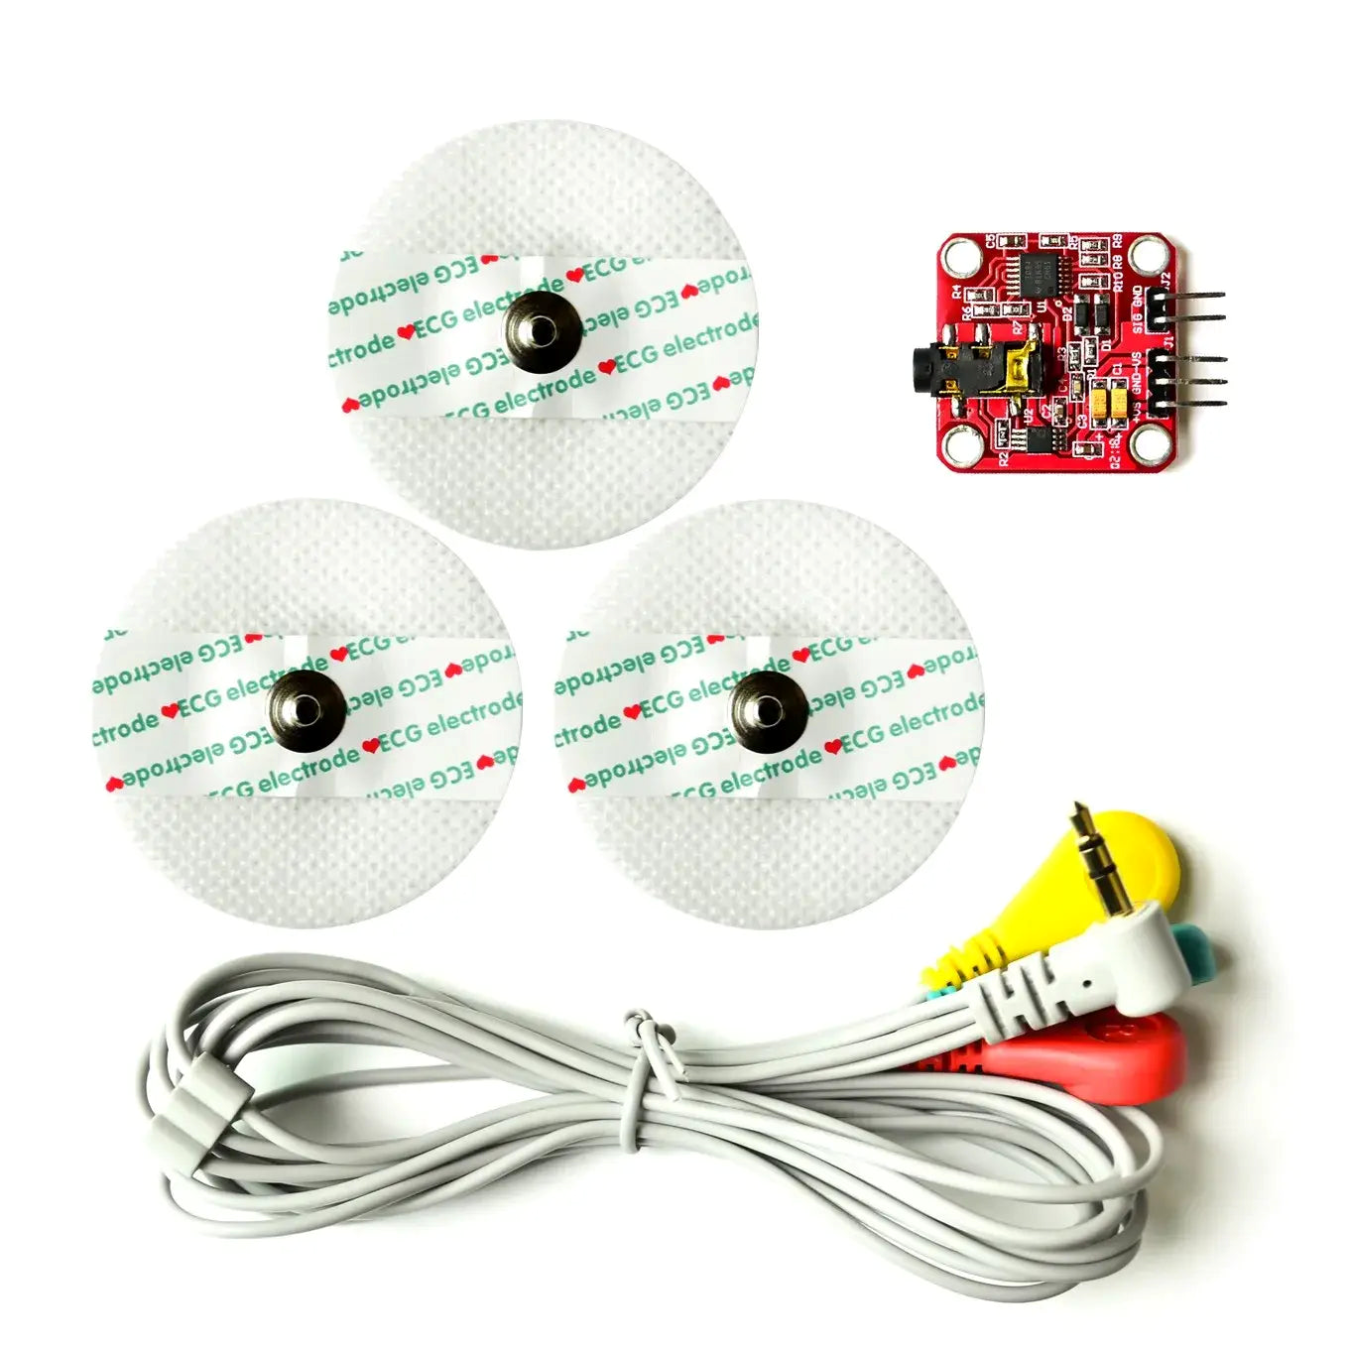

Introduction(Continued)
In this project, we are using lightweight metal, electromyography sensor, embedded microcontroller, Gear motors and inertial measurement unit.
The device has a lightweight metal frame for strength and comfort, allowing easy movement. Electromyography (EMG) sensors detect muscle signals, enabling intuitive responses.
Hybrid Assistive Limb uses a microcontroller to process data and control movements. It has Gear motors for smooth, muscle-based motions, a battery for easy portability, and an inertial measurement unit to track joint movement and orientation.
Figure 2: A wheelchair
CUI, Attock
FYP-Innovative wearable robotics for enhancing lower limb mobility and function.

Slide 6
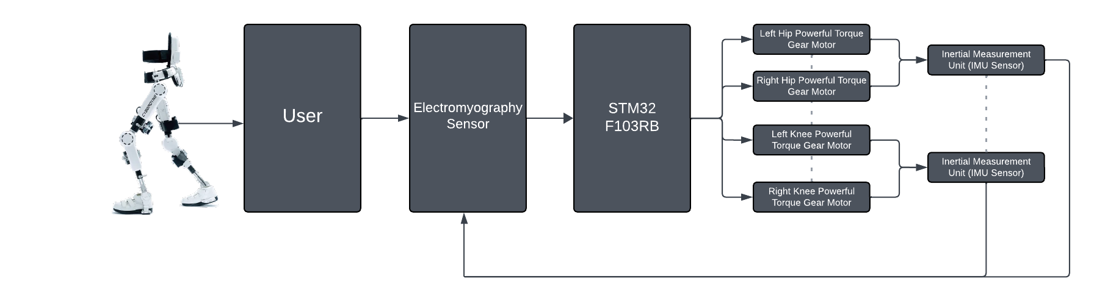
Block Diagram
Figure 7: Block Diagram

Slide 7
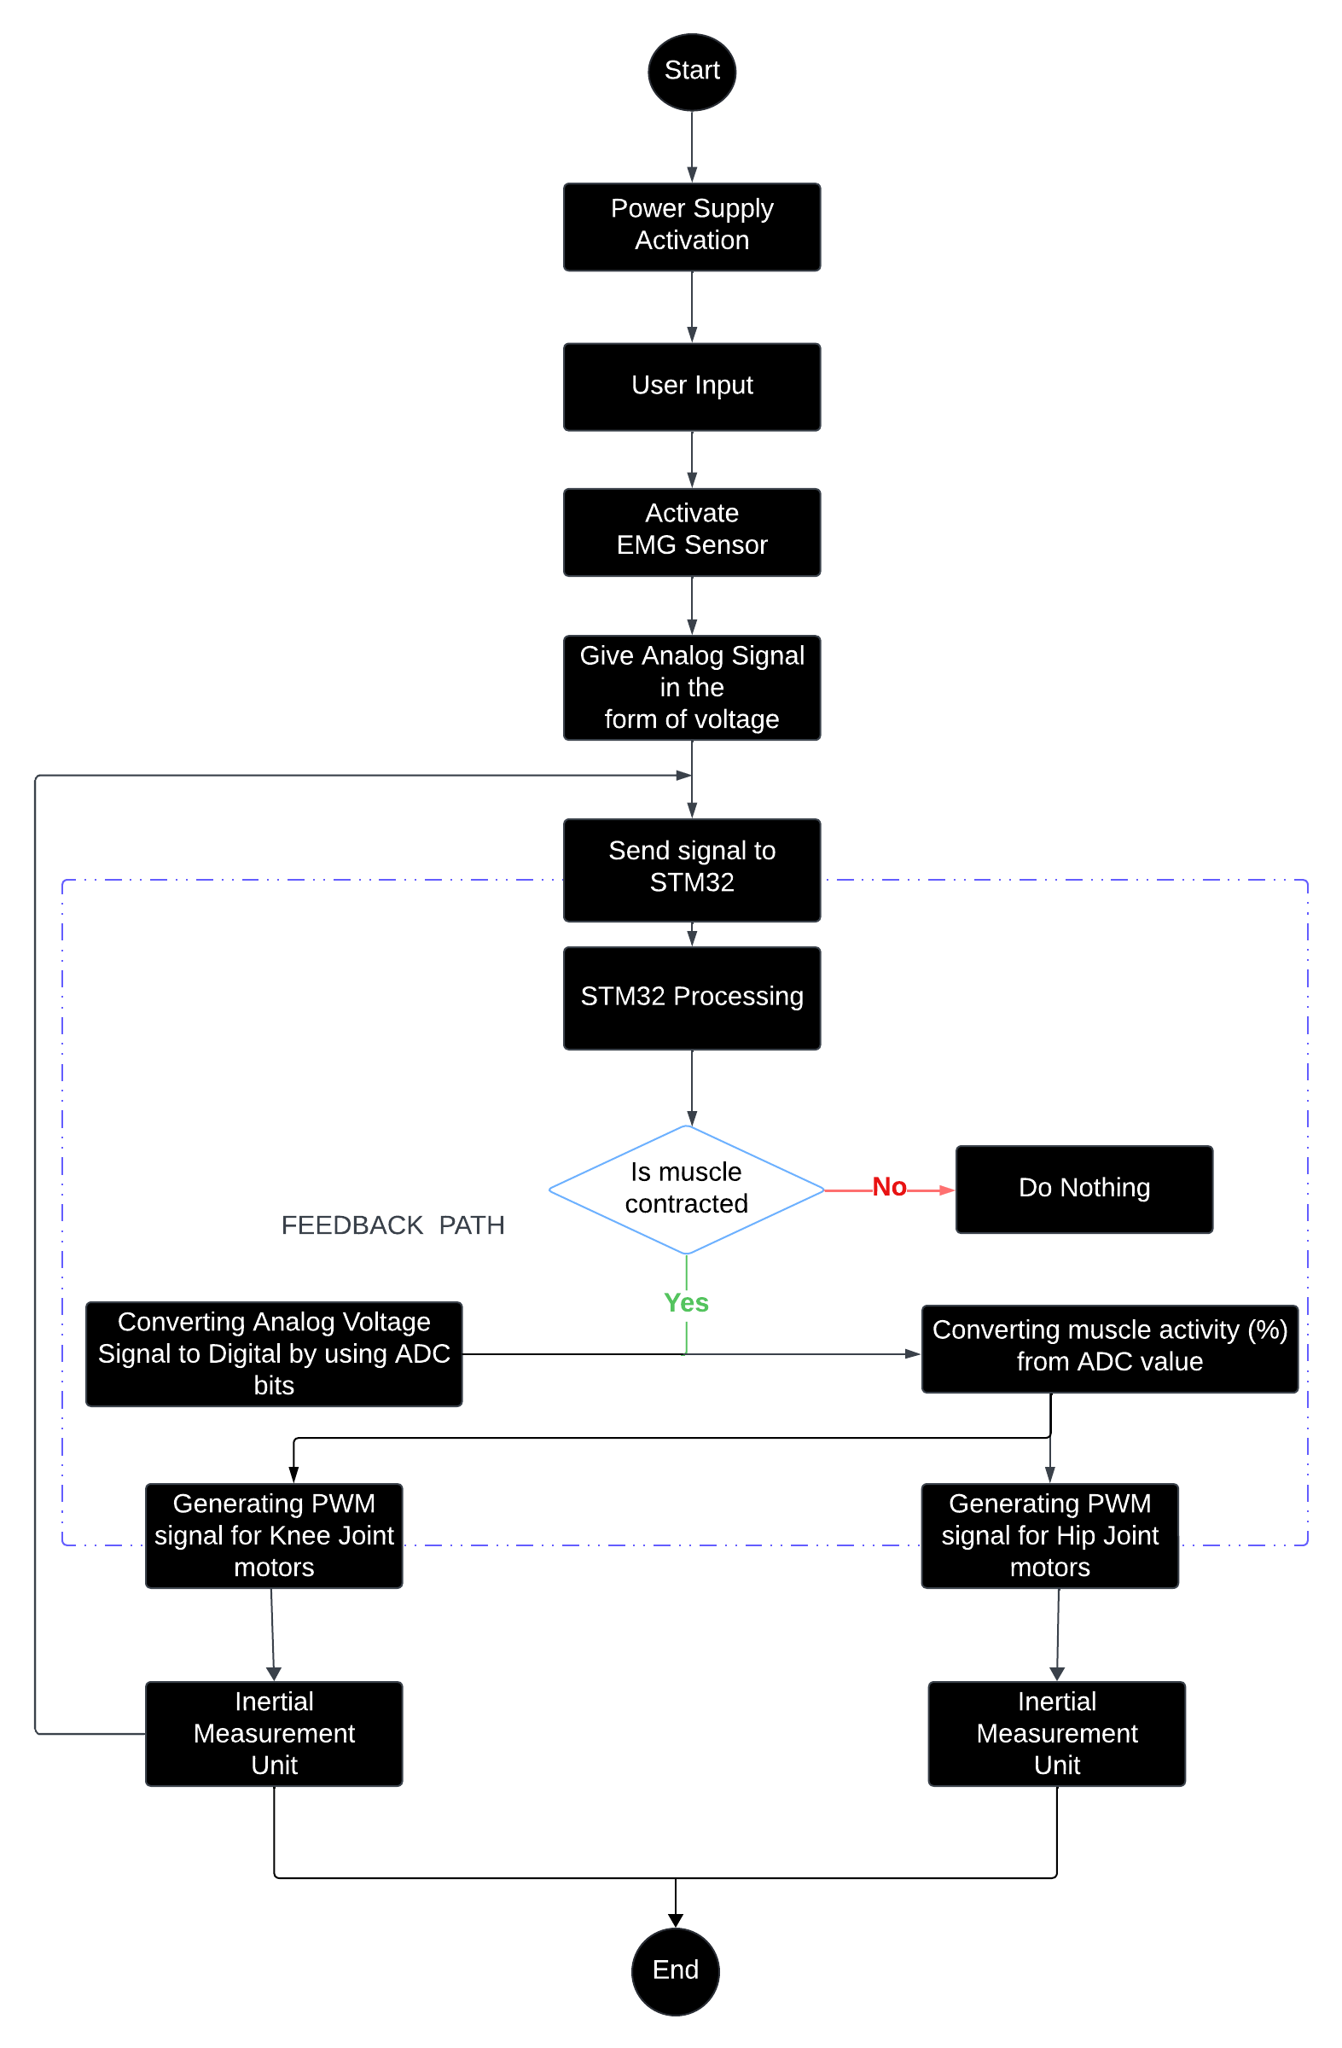
Flowchart

Slide 8
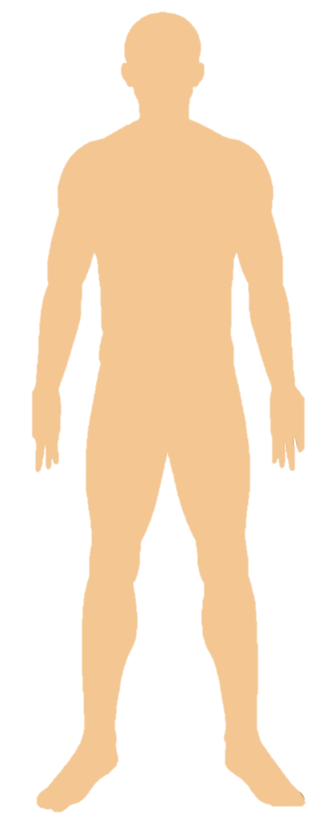
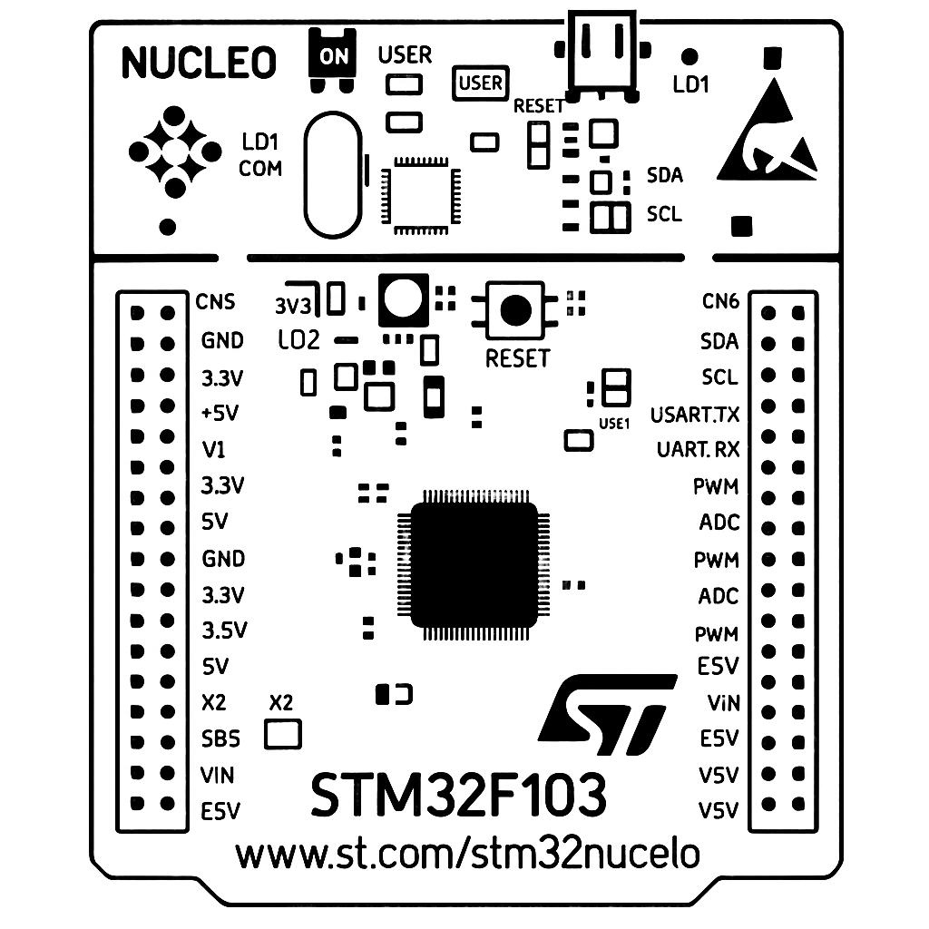
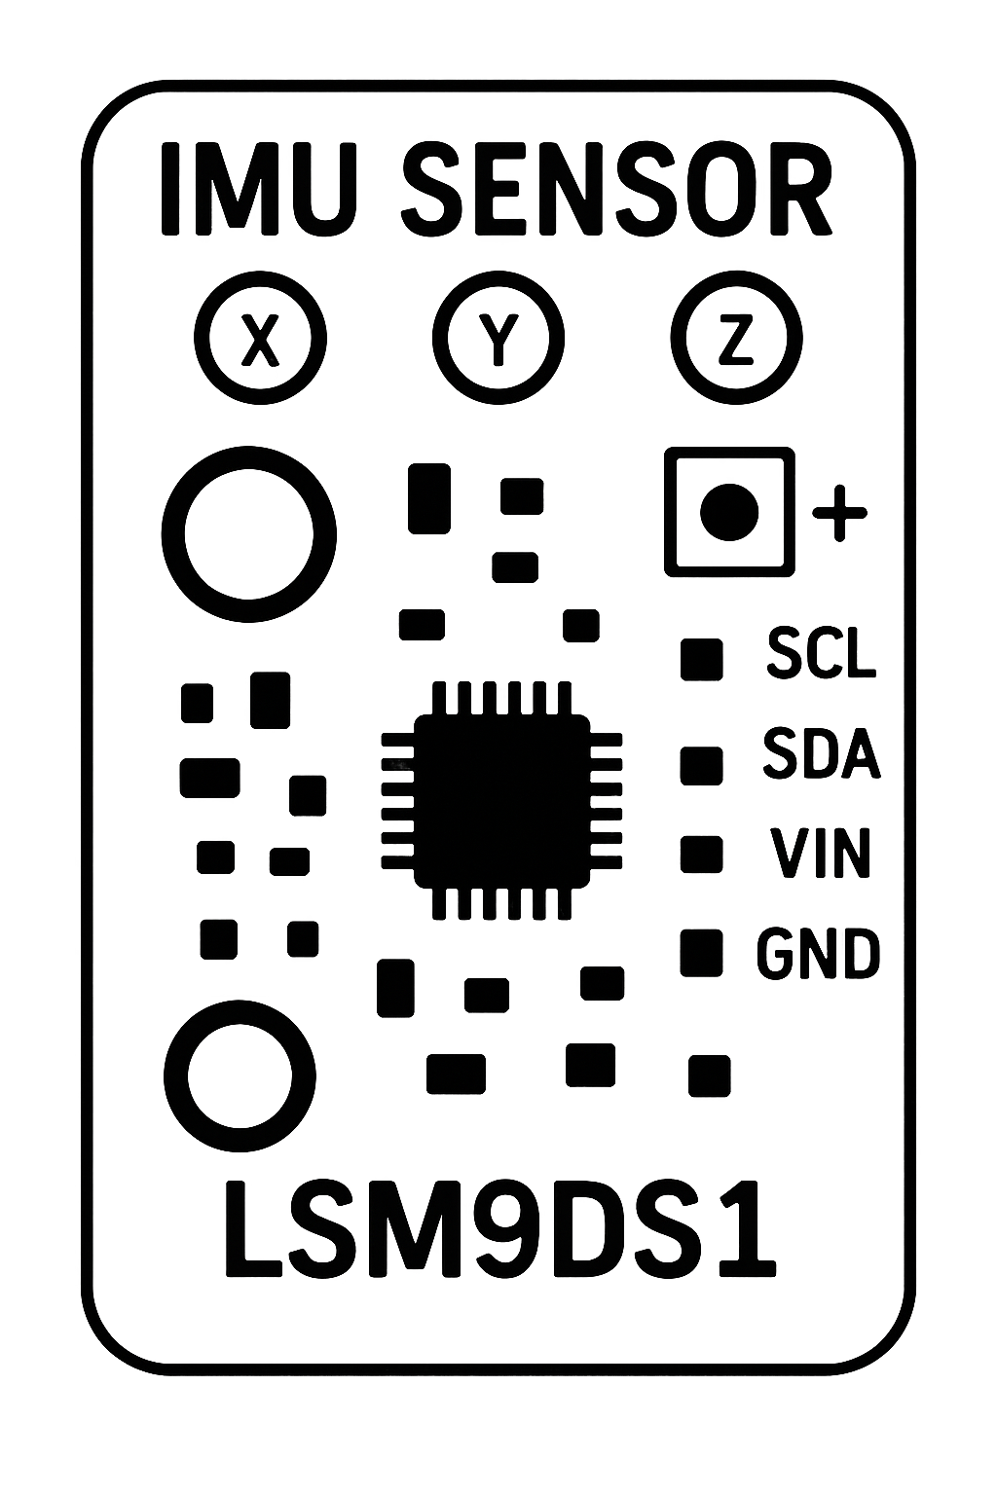

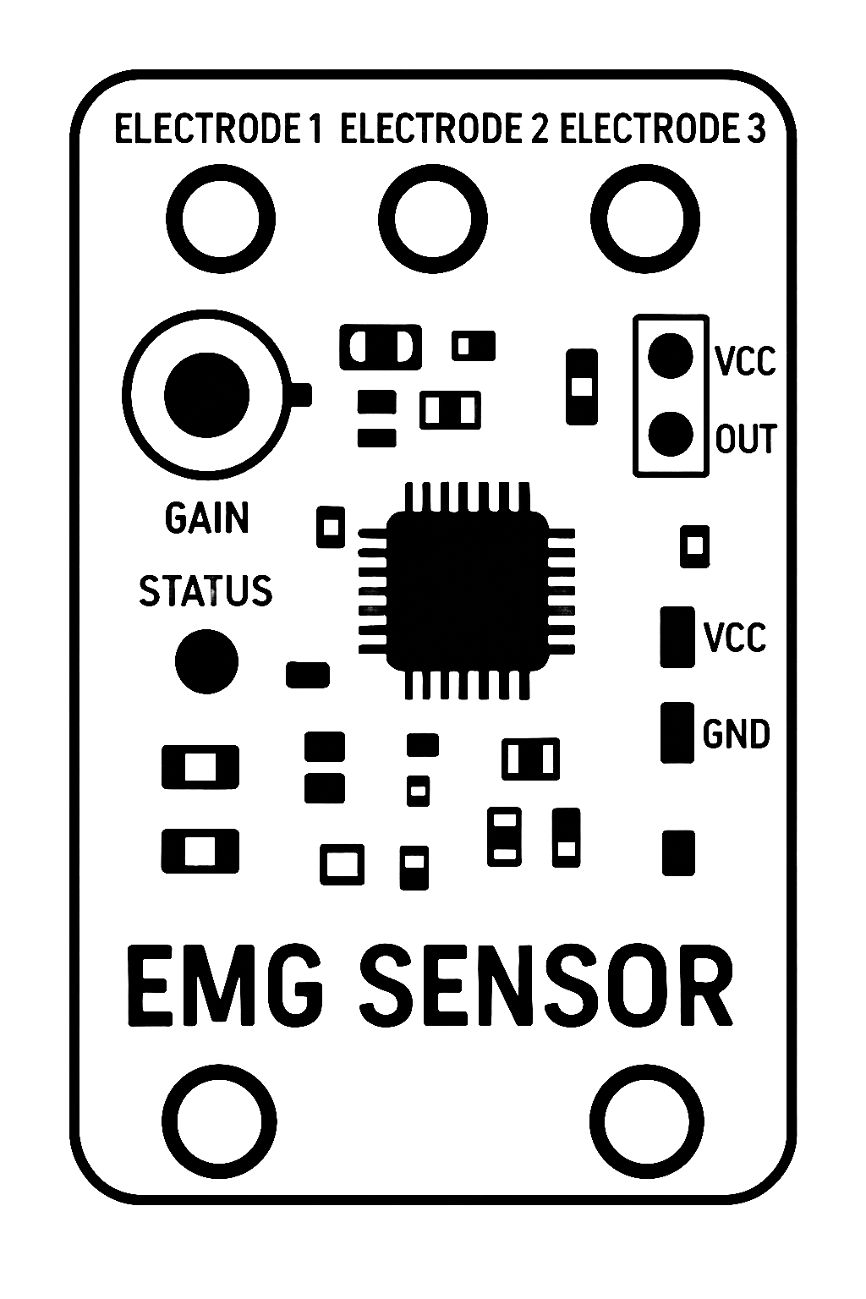
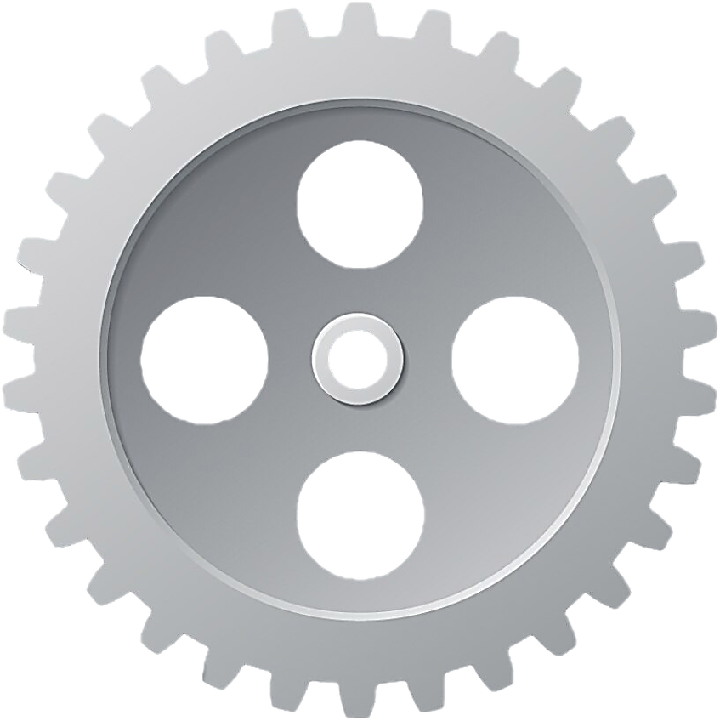
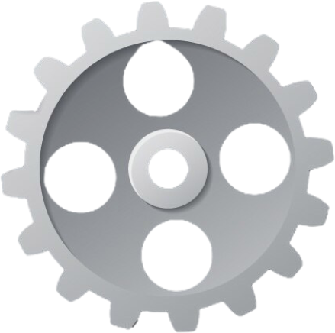
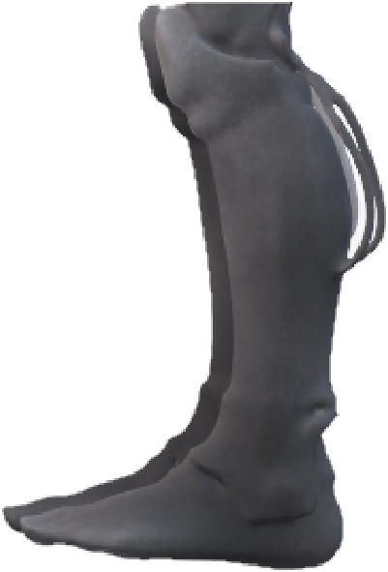
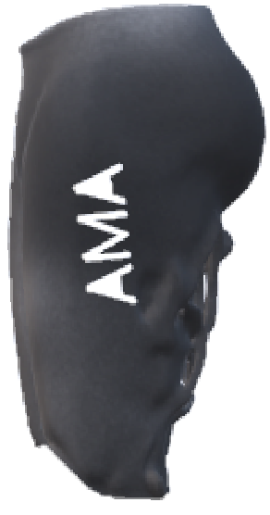
Animation
Gear reduction system to increase torque while reducing output speed.
FEEDBACk
PATH
)))
MONITOR JOINTS ANGLE USING IMU AND STOP MOTOR AT
TARGET ANGLE

Slide 9
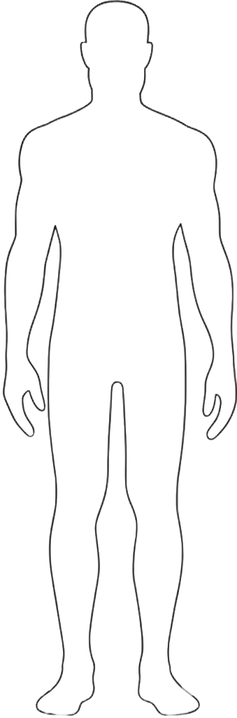
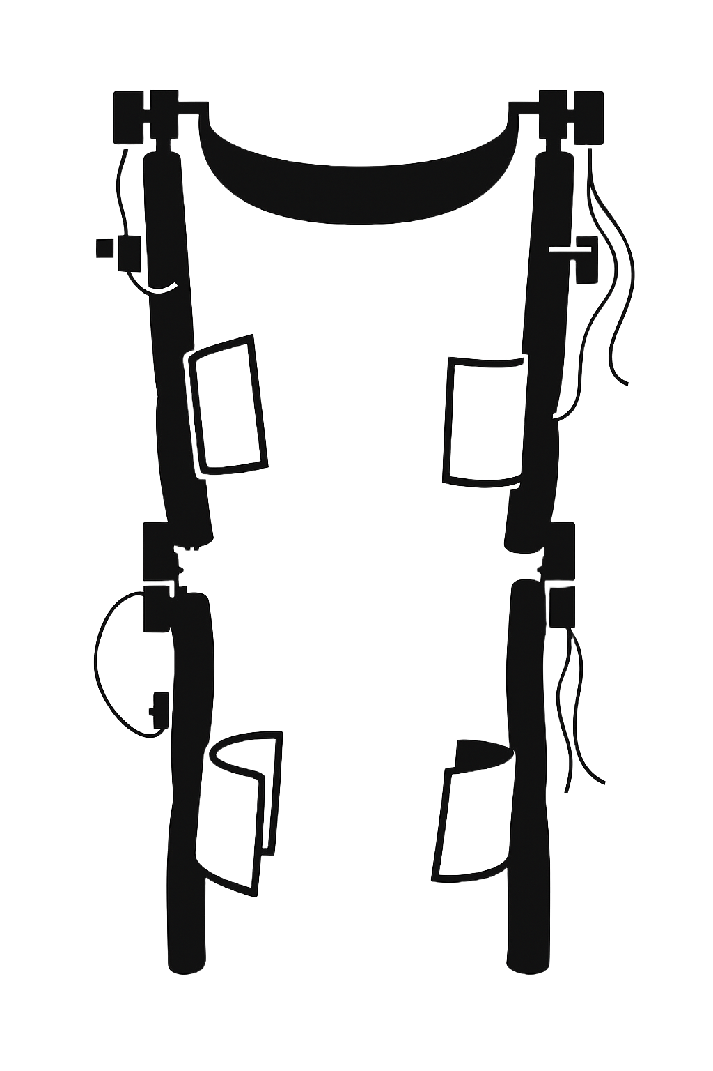



Placement
STM32 f103RB
HUMAN
DC Gearmotor on Hip Joint
IMU Sensor-1
EMG Sensor
DC Gearmotor on Knee Joint
IMU Sensor-2

Slide 10
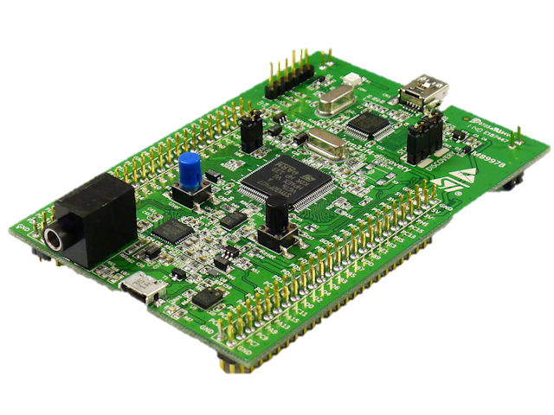
Working
Electromyography Muscle Sensor
The electromyography Muscle Sensor detects electrical signals generated by muscles during contraction using surface electrodes.
It amplifies and filters these signals to produce a clean analog voltage proportional to muscle activity.
The output voltage ranges from 0V (relaxed muscle) to Vin (maximum contraction) based on the sensor's power supply.
Muscle generate small voltages typically in microvolts (µv).
EMG sensor amplifies it:
Vout ​=G × Vmuscle​
.
Figure 3: Electromyography Sensor
CUI, Attock
FYP-Innovative wearable robotics for enhancing lower limb mobility and function.

Slide 11
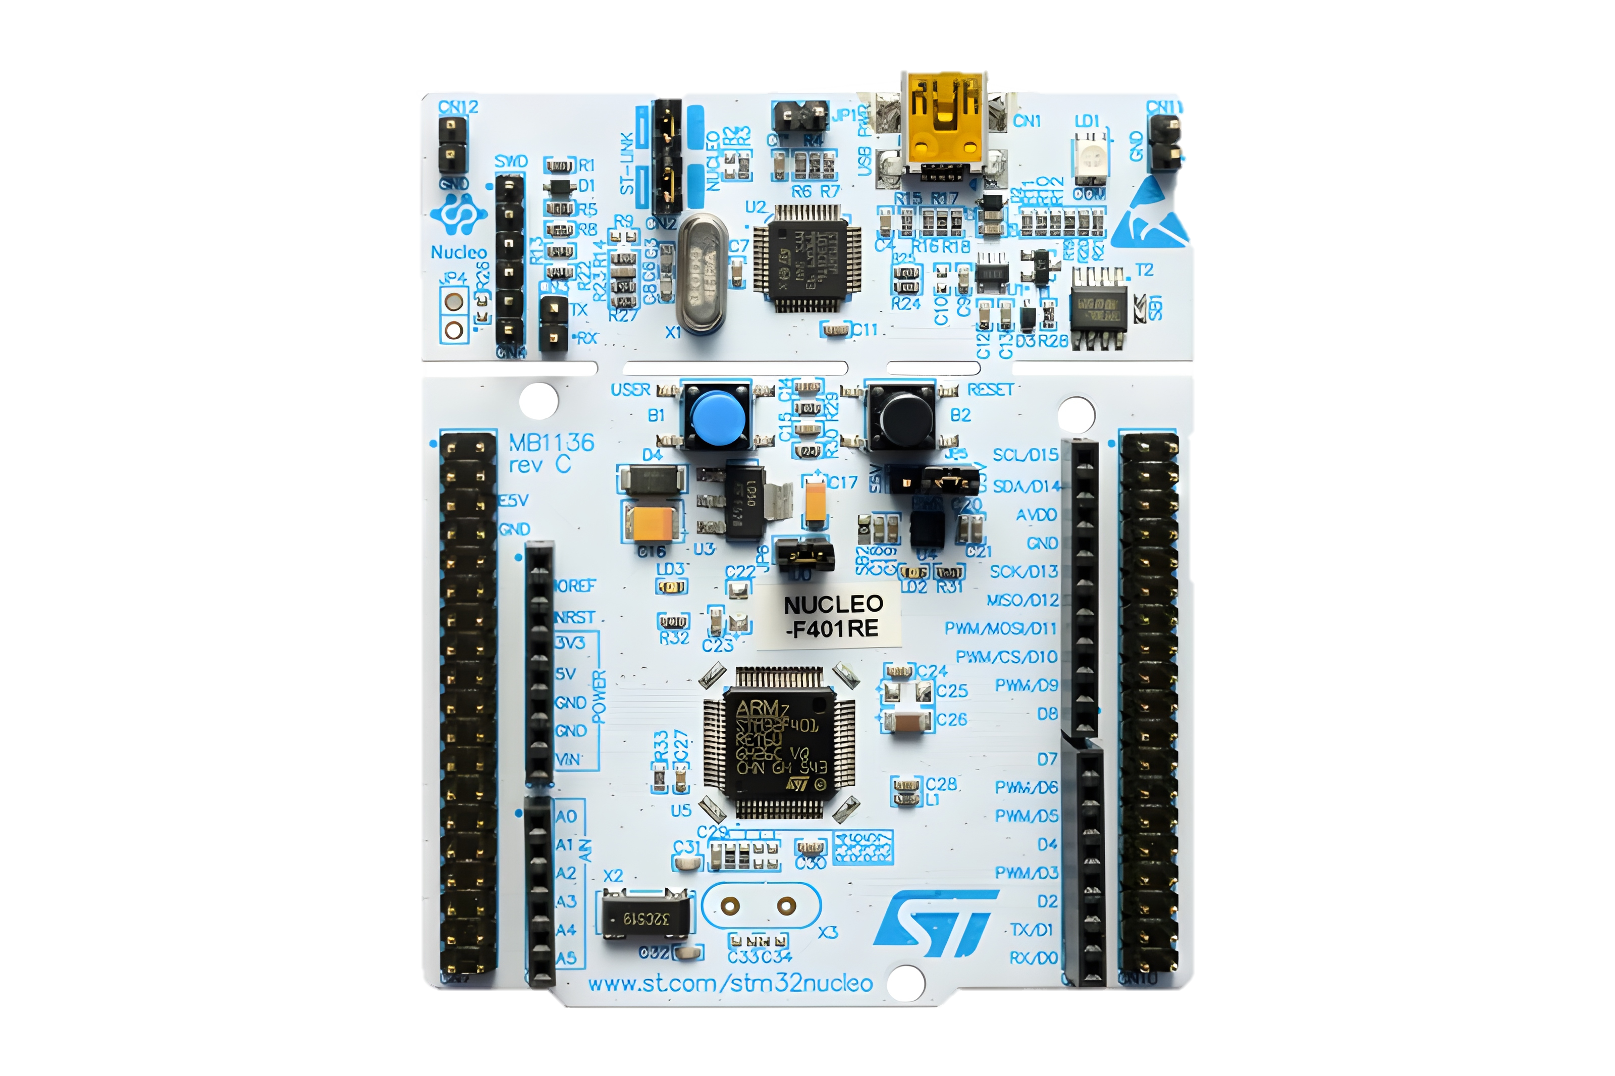
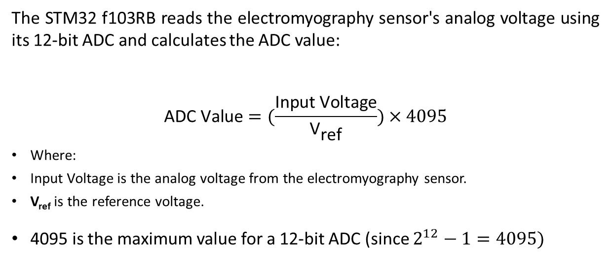
Working (Continue)
STM32 f103RB
The STM32 f103RB reads the electromyography sensor's analog voltage using its 12-bit ADC and calculates the ADC value:
$$\text{ADC} \text{Value}=(\frac{\text{Input} \text{Voltage}}{{\text{V}}_{\text{ref}}})×4095$$
Where:
Input Voltage is the analog voltage from the electromyography sensor.
V_{ref} is the reference voltage.
4095 is the maximum value for a 12-bit ADC (since $2^{12}−1=4095)$
Figure 4: STM32 NUCLEO-F103RB
CUI, Attock
FYP-Innovative wearable robotics for enhancing lower limb mobility and function.

Slide 12
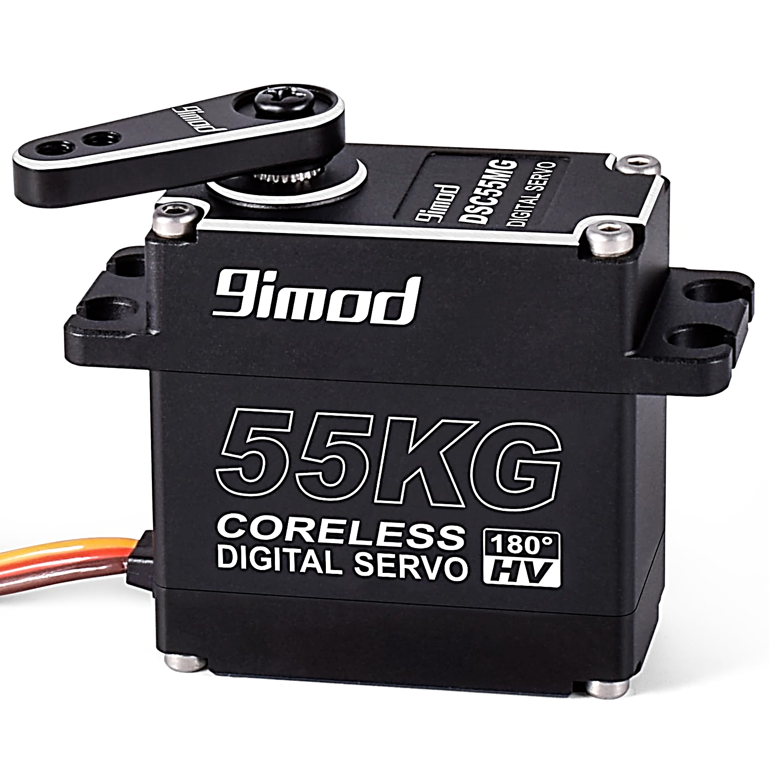
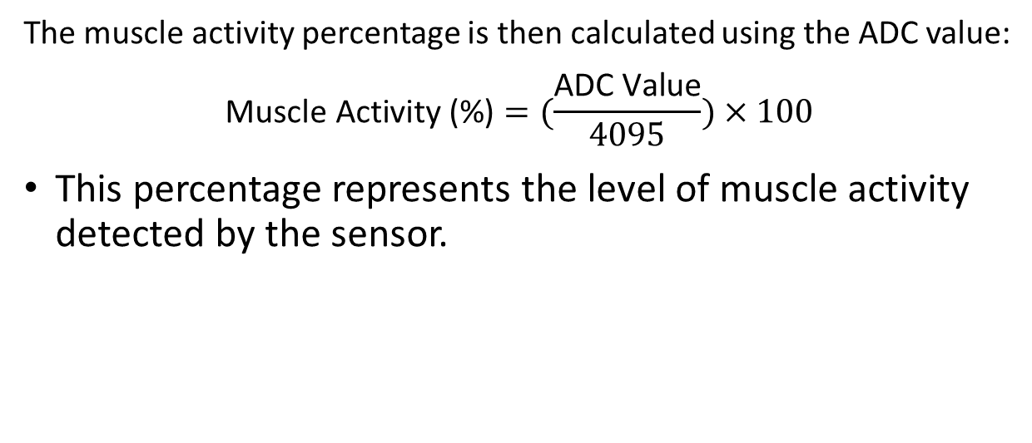
Working (Continue)
STM32 f103RB
The muscle activity percentage is then calculated using the ADC value:
$$\text{Muscle} \text{Activity}\text{ (\%)}=(\frac{\text{ADC} \text{Value}}{4095})×100$$
This percentage represents the level of muscle activity detected by the sensor.
Figure 4: STM32 f103RB
CUI, Attock
FYP-Innovative wearable robotics for enhancing lower limb mobility and function.

Slide 13
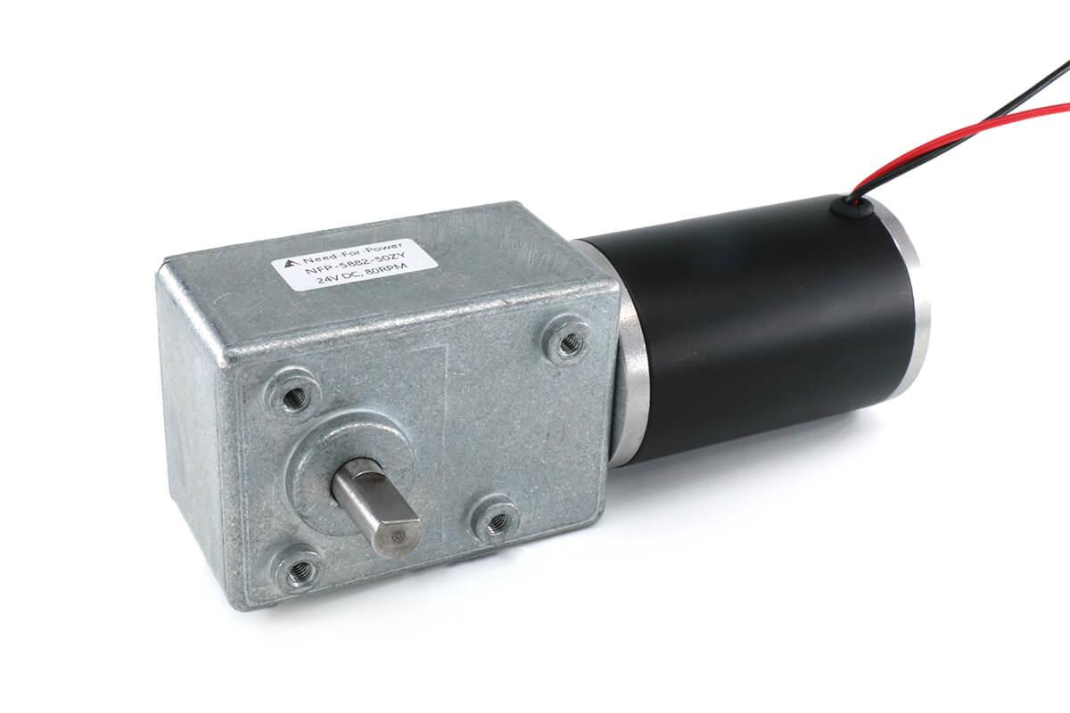
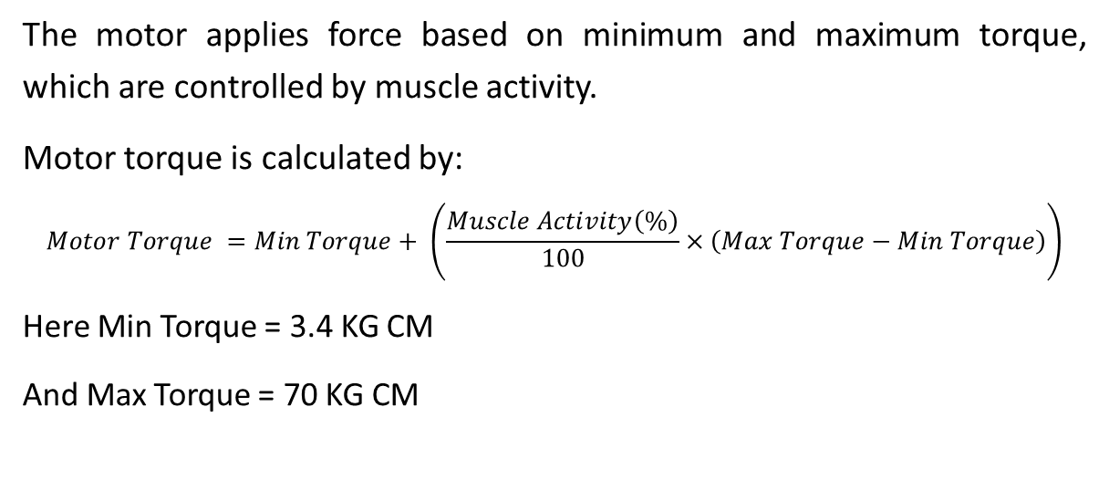
Working (Continue)
Powerful Torque Gear
The motor applies force based on minimum and maximum torque, which are controlled by muscle activity.
Motor torque is calculated by:
$$Motor Torque =Min Torque+ \left(\frac{Muscle Activity\left(\%\right)}{100}×\left(Max Torque−Min Torque\right)\right)$$
Here Min Torque = 3.4 KG CM
And Max Torque = 70 KG CM
Figure 5: Powerful Torque Gearmotor
CUI, Attock
FYP-Innovative wearable robotics for enhancing lower limb mobility and function.

Slide 14
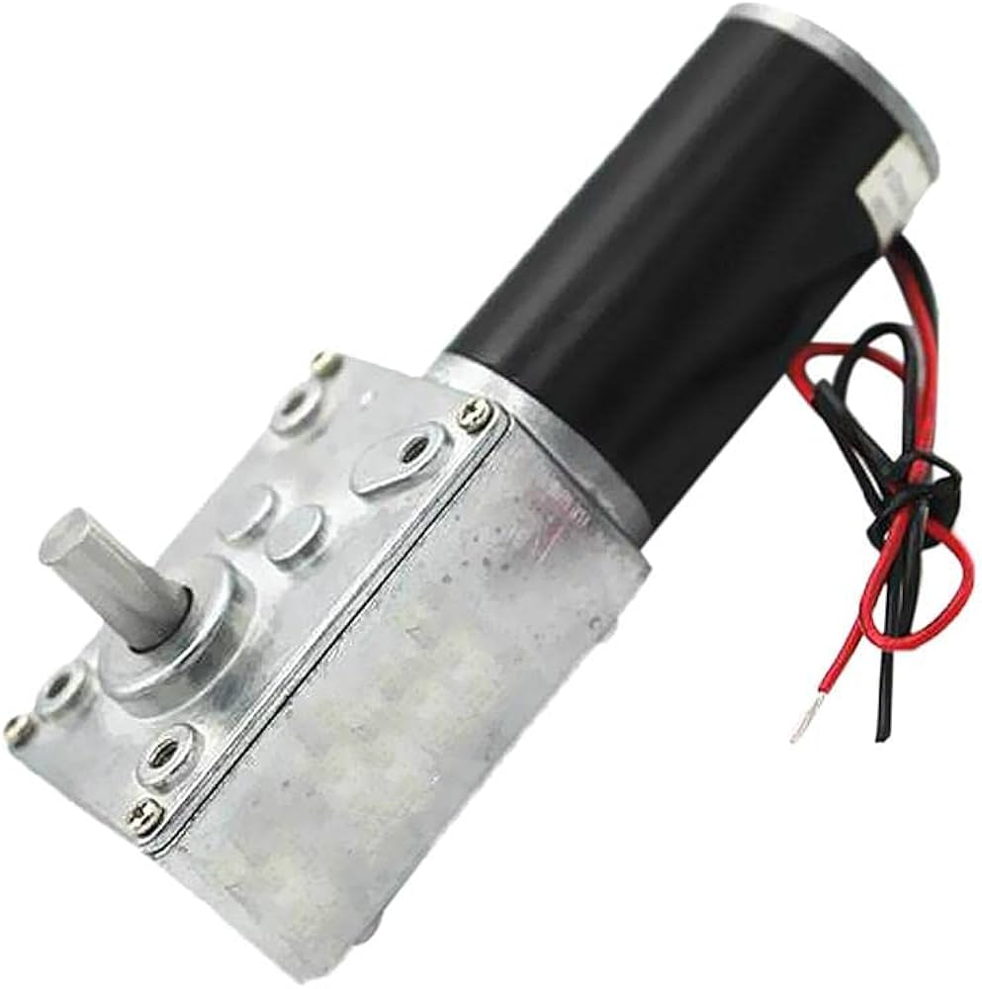
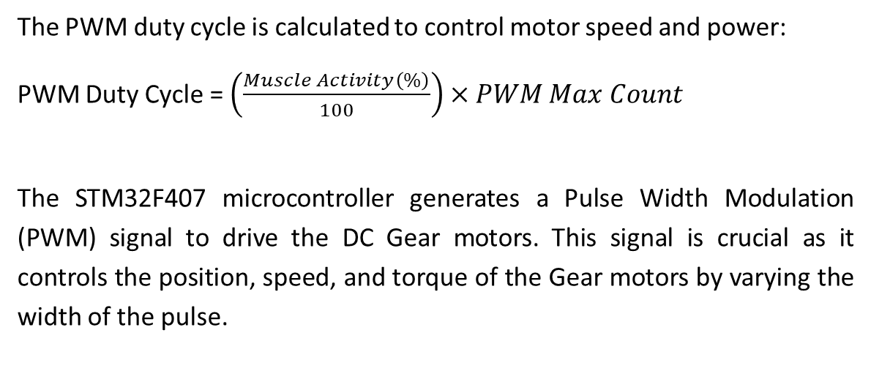
Working (Continue)
Powerful Torque Gearmotor
The PWM duty cycle is calculated to control motor speed and power:
PWM Duty Cycle = $\left(\frac{Muscle Activity\left(\%\right)}{100}\right)×PWM Max Count$
The STM32F407 microcontroller generates a Pulse Width Modulation (PWM) signal to drive the DC Gear motors. This signal is crucial as it controls the position, speed, and torque of the Gear motors by varying the width of the pulse.
Figure 5: Powerful Torque Gearmotor
CUI, Attock
FYP-Innovative wearable robotics for enhancing lower limb mobility and function.

Slide 15
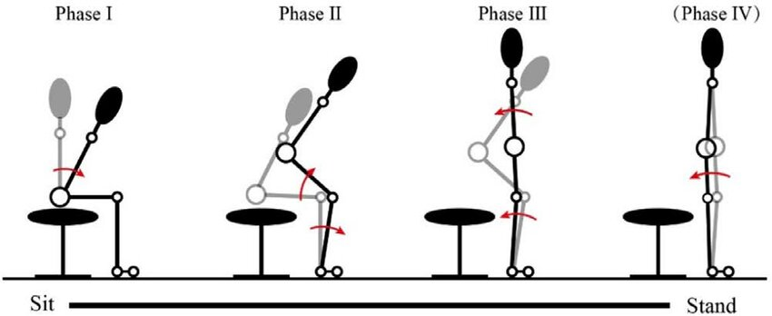
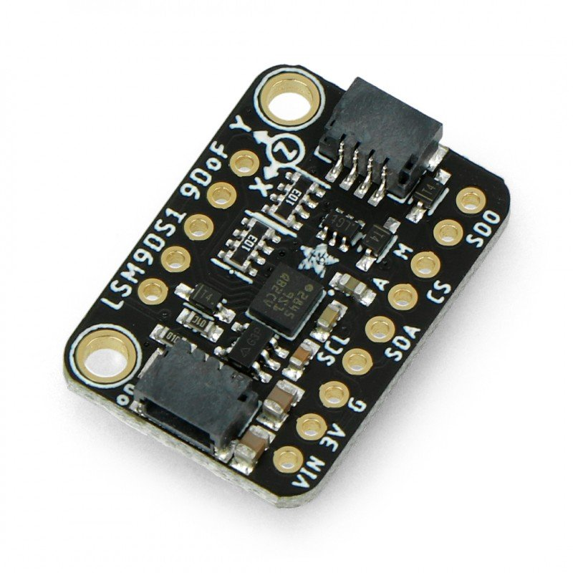
Working (Continue)
Hip and knee joint angle during sit to stand
Flexion Angles
Phase 1: Knee = 90°, Hip = 93°
Phase 2: Knee = 60°, Hip = 60°
Extension Angles
Phase 1: Knee = 0°, Hip = 0°
Phase 2: Knee = 30°, Hip = 30°
CUI, Attock
FYP-Innovative wearable robotics for enhancing lower limb mobility and function.

Slide 16
Working (Continue)
Hip and knee joint angle during sit to stand
Flexion Angles
Phase 3: Knee = 30°, Hip = 30°
Phase 4: Knee = 0°, Hip = 0°
Extension Angles
Phase 3: Knee = 60°, Hip = 60°
Phase 4: Knee = 90°, Hip = 90°
CUI, Attock
FYP-Innovative wearable robotics for enhancing lower limb mobility and function.

Slide 17

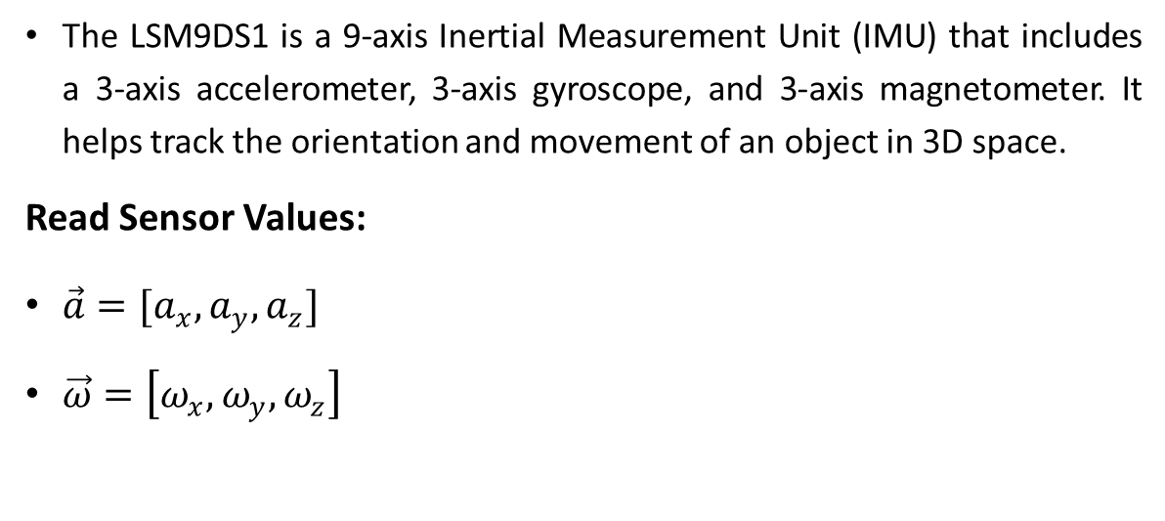
Working (Continue)
Inertial Measurement Unit (LSM9DS1)
The LSM9DS1 is a 9-axis Inertial Measurement Unit (IMU) that includes a 3-axis accelerometer, 3-axis gyroscope, and 3-axis magnetometer. It helps track the orientation and movement of an object in 3D space.
Read Sensor Values:
$\vec{a}=[a_{x},a_{y},a_{z}]$
$\vec{ω}=\left[ω_{x},ω_{y},ω_{z}\right]$
Figure 6: IMU Sensor (GY-85 9DOF)
CUI, Attock
FYP-Innovative wearable robotics for enhancing lower limb mobility and function.

Slide 18
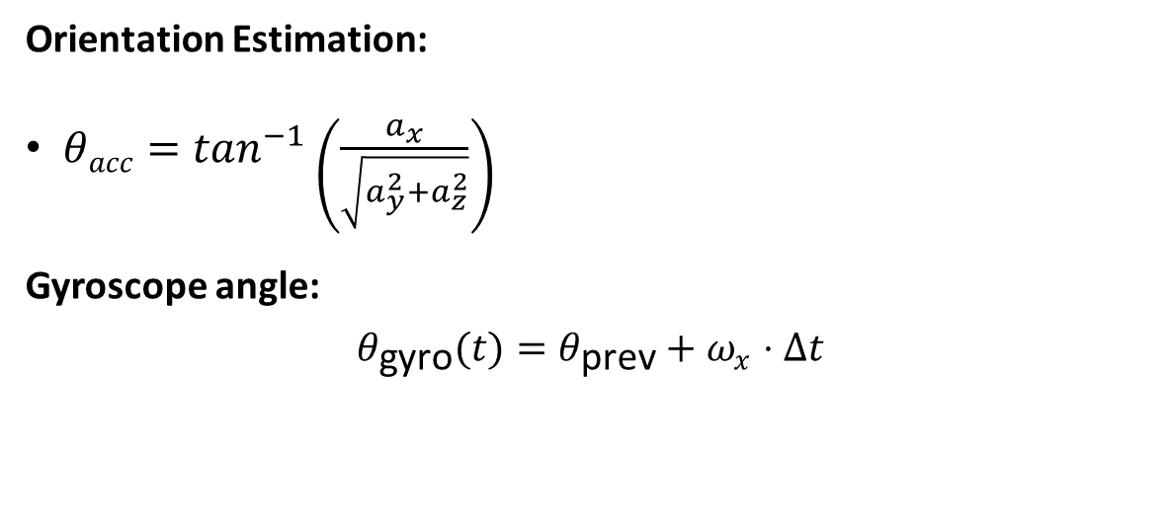
Working (Continue)
Inertial Measurement Unit (LSM9DS1)
Orientation Estimation:
$θacc=\tan^{−1}\left(\frac{a_{x}}{\sqrt{a_{y}^{2}+a_{z}^{2}}}\right)$
Gyroscope angle:
$$θ_{\text{gyro}}(t)=θ_{\text{prev}}+ω_{x}⋅Δt$$
Figure 6 : IMU Sensor (LSM9DS1)
CUI, Attock
FYP-Innovative wearable robotics for enhancing lower limb mobility and function.

Slide 19
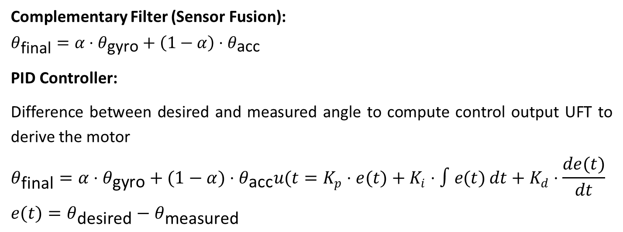
Working (Continue)
Inertial Measurement Unit (LSM9DS1)
Complementary Filter (Sensor Fusion):
$$θ_{\text{final}}=α⋅θ_{\text{gyro}}+\left(1−α\right)⋅θ_{\text{acc}}$$
PID Controller:
Difference between desired and measured angle to compute control output UFT to derive the motor
$$θ_{\text{final}}=α⋅θ_{\text{gyro}}+(1−α)⋅θ_{\text{acc}}u(t=K_{p}⋅e(t)+K_{i}⋅∫e(t) dt+K_{d}⋅\frac{de(t)}{dt}$$
$$e(t)=θ_{\text{desired}}−θ_{\text{measured}}$$
Figure 6 : IMU Sensor (LSM9DS1)
CUI, Attock
FYP-Innovative wearable robotics for enhancing lower limb mobility and function.

Slide 20

Problem Statement
Many individuals over the age of 60 face significant mobility challenges, often leading to increased dependency on caregivers or becoming bedridden.
Existing mobility devices are typically expensive and primarily used in clinical settings, limiting access for ordinary seniors at home.
This creates a gap in affordable, user-friendly solutions that support independence for the aging population.
Figure 6: Problem statement
CUI, Attock
FYP-Innovative wearable robotics for enhancing lower limb mobility and function.
This Photo by Unknown Author is licensed under CC BY

Slide 21
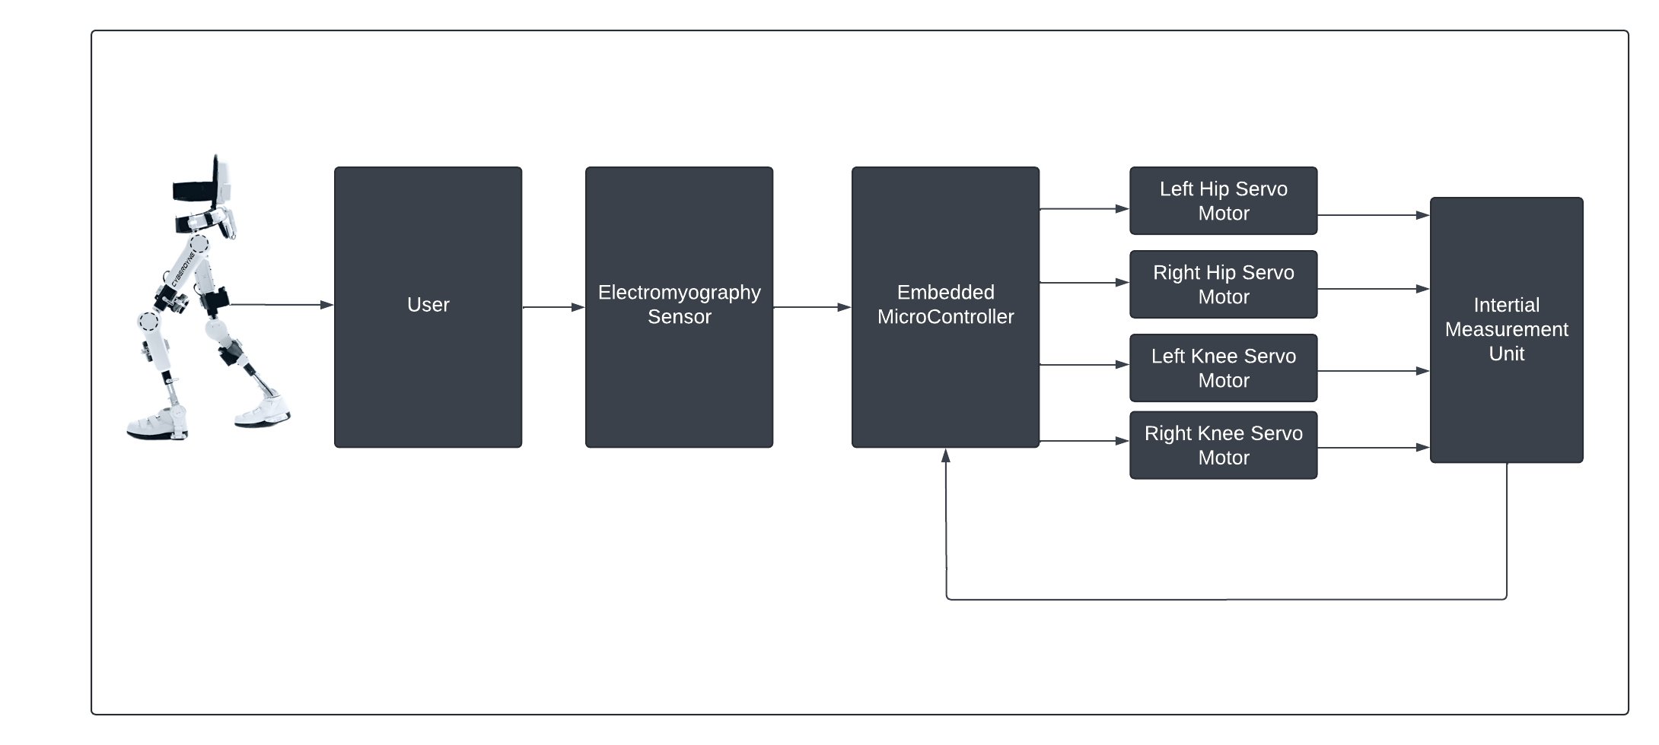
Objectives
Created a CAD model for a wearable device and mechanical frame that enhances user mobility and independence in daily activities.
To provide a power supply that ensures continuous operation of all components including the sensors, microcontroller. Gear motors, and mechanical structure.
To implement a process control system for data acquisition and control actuators to move the limb smoothly and precisely.
To design and construct a mechanical structure (frame and joints) that supports and move the limb effectively.
To incorporate machine learning algorithms to optimize the system's performance by using Proportional integral derivative(PID) controller (Optional).
Figure 6: Objectives
CUI, Attock
Innovative wearable robotics for enhancing lower limb mobility and function.

Slide 22



Benefits to society
Helps people with mobility challenges move independently and confidently.
Allows users to perform daily tasks with greater ease.
Gives users more freedom, reducing stress on caregivers significantly.
CUI, Attock
FYP-Innovative wearable robotics for enhancing lower limb mobility and function.

Slide 23
UN’s Sustainable Development Goals
This project helps people with disabilities move better and live independently.
It uses new technology to create better assistive devices for healthcare.
CUI, Attock
FYP-Innovative wearable robotics for enhancing lower limb mobility and function.

Slide 24
Project Timeline
No. | Starting Week Date | Description Of Milestone | Duration In Week
1 | 04-09-24 | Project Planning And Research | 4 weeks
2 | 02-10-24 | Literature Review and Background Research | 3 weeks
3 | 23-10-24 | Requirement Analysis and Specification | 2 weeks
4 | 06-11-24 | Design and Architecture | 3 weeks
5 | 27-11-24 | Implementation and Prototyping | 5 weeks
6 | 01-01-25 | Testing and Quality Assurance | 4 weeks
7 | 29-01-25 | Data Collection and Analysis | 5 weeks
8 | 03-03-25 | Hardware Implementation and Trouble shooting | 6 weeks
9 | 14-04-25 | Presentation Preparation and Rehearsal | 4 weeks
10 | 05-06-25 | Final Presentation, Evaluation, and Submission | 5 weeks
CUI, Attock
FYP-Innovative wearable robotics for enhancing lower limb mobility and function.

Slide 25
References
Kato, K.& Kawamoto ,H.(2013). Developing a Innovative wearable robotics for enhancing lower limb mobility and function. for helping people
Move. Journal of Robotics and Mechatronics,25(1),25-32.
Yamamoto, T.& Takeda ,K.(2015).Using Robots to assist rehabilitation. IEEE transactions on Robotics and Automation,31(2),205-217.
CUI, Attock
FYP-Innovative wearable robotics for enhancing lower limb mobility and function.

Slide 26

Literature Review
Year | Author | Paper/Thesis Title | Findings
2015 | Zhang H., Wang L., Huang Y. | Development of a Wearable Robotic Exoskeleton for Lower Limb Rehabilitation | The device assists individuals with mobility impairments by providing active assistance in knee and hip joints, allowing for adjustable levels of support depending on user needs.
2018 | Kim J., Lee S., Park H. | Design of a Lightweight Powered Exoskeleton for Lower Limb Assistance | This exoskeleton is designed with lightweight materials and optimized actuator placement to reduce user fatigue and provide comfortable support during walking..
CUI, Attock
FYP-Innovative wearable robotics for enhancing lower limb mobility and function.

Slide 27
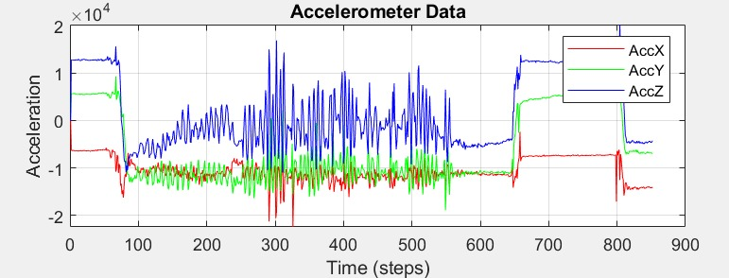
Recommendations and Suggestions
Recommendations:
Working of Signal from Sensor to Controller and Then to Motor.
Coordination of Hip and knee joints
Flow Chart Showing Ranges of Angles/Orientations
IMU Sensor
Suggestions:
Flowchart adjustment in slide (Size)
Correction in Fourth objective
Enhance animation
Figure 8: Recommendations and Suggestions
CUI, Attock
Innovative wearable robotics for enhancing lower limb mobility and function.

Slide 28
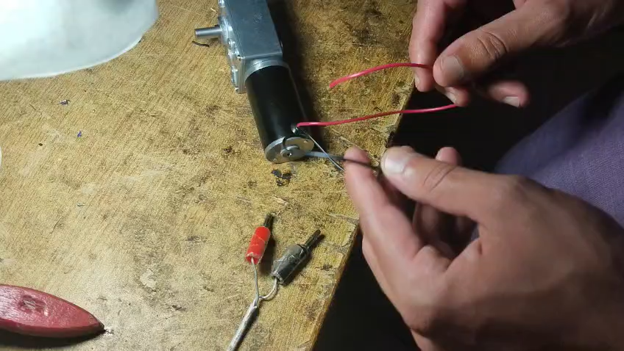
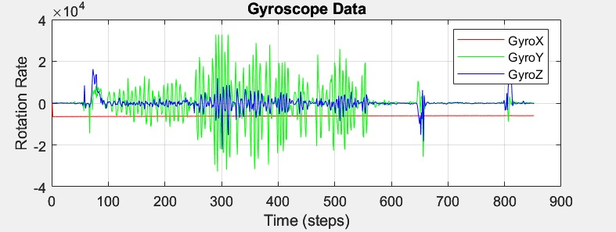
Results
Motor Testing:
CUI, Attock
Innovative wearable robotics for enhancing lower limb mobility and function.

Slide 29
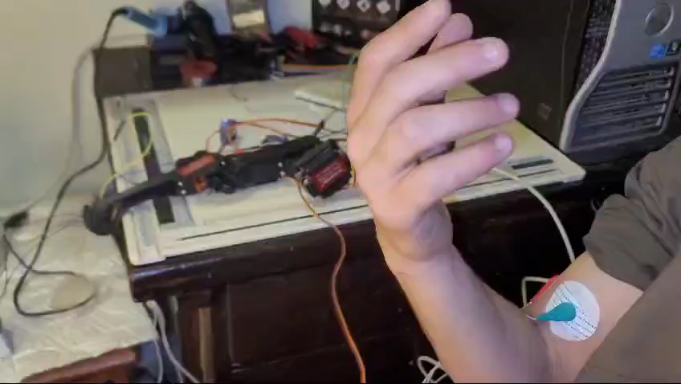
Results
EMG Sensor Testing:
CUI, Attock
Innovative wearable robotics for enhancing lower limb mobility and function.

Slide 30
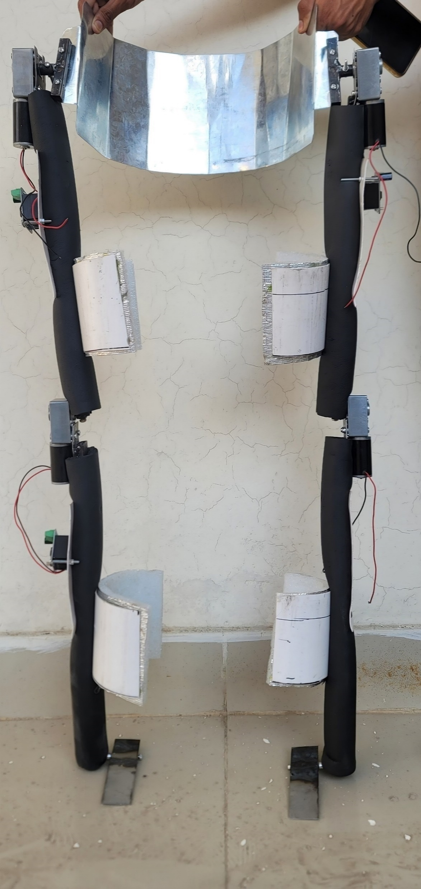
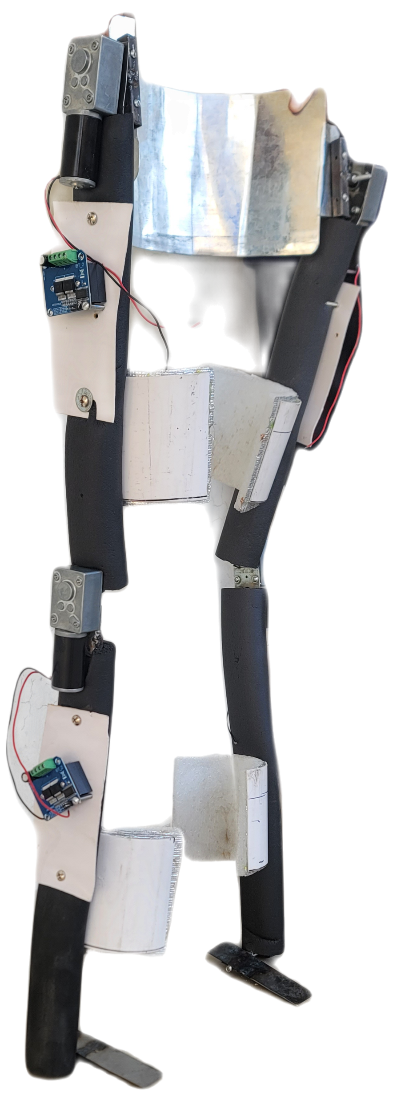
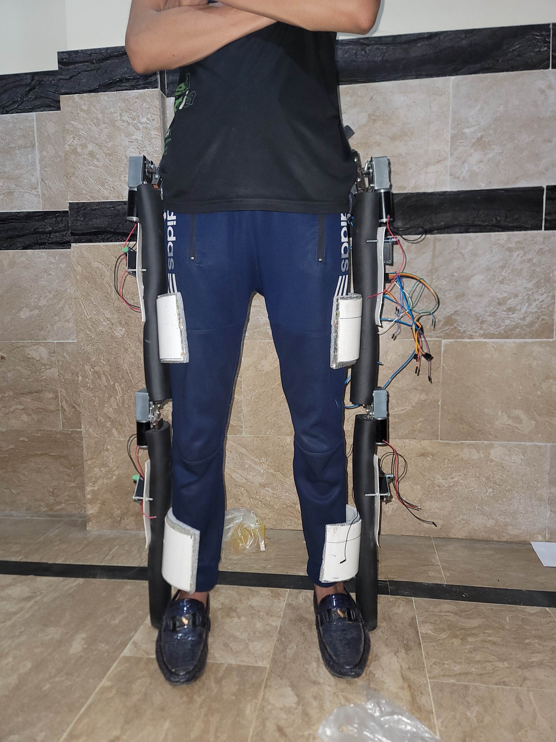
Results
CUI, Attock
Innovative wearable robotics for enhancing lower limb mobility and function.

Slide 31
Results
Inertial Measurement Unit (IMU) Testing:
Accelerometer
An accelerometer is a device that measures proper acceleration, which is the rate of change of velocity of an object.
This graph is plotted on MATLAB by interfacing it with the Arduino IDE. The hardware components I used are an inertial measurement unit (MPU 6050) and an Arduino UNO
CUI, Attock
Innovative wearable robotics for enhancing lower limb mobility and function.

Slide 32
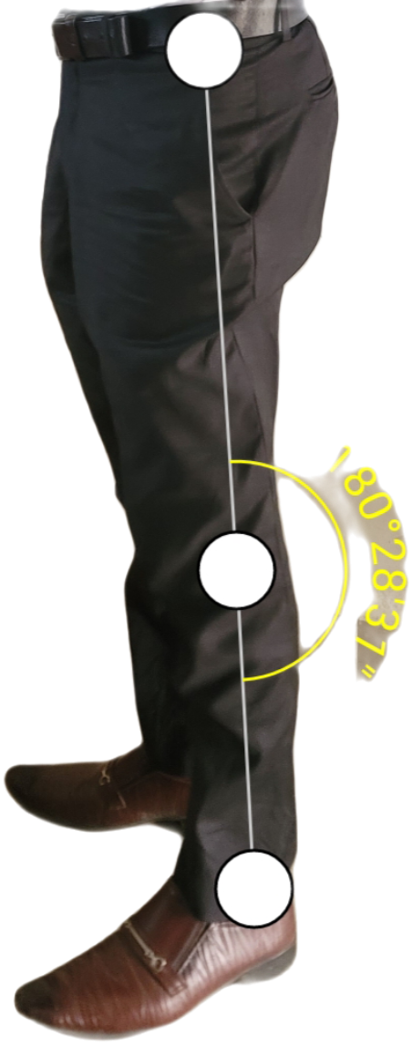
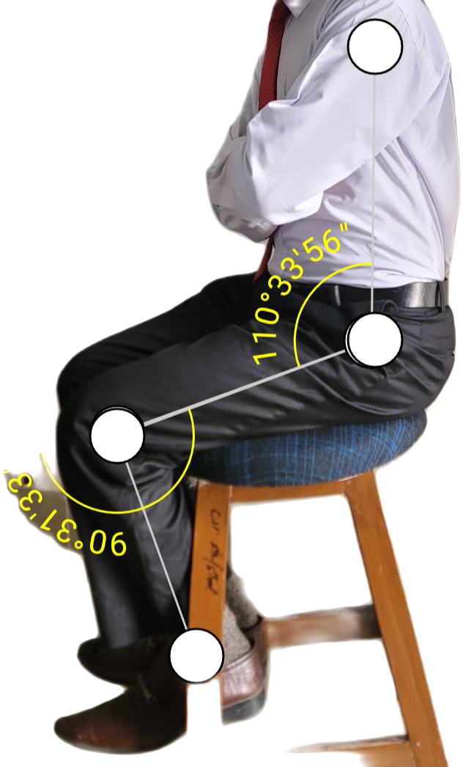
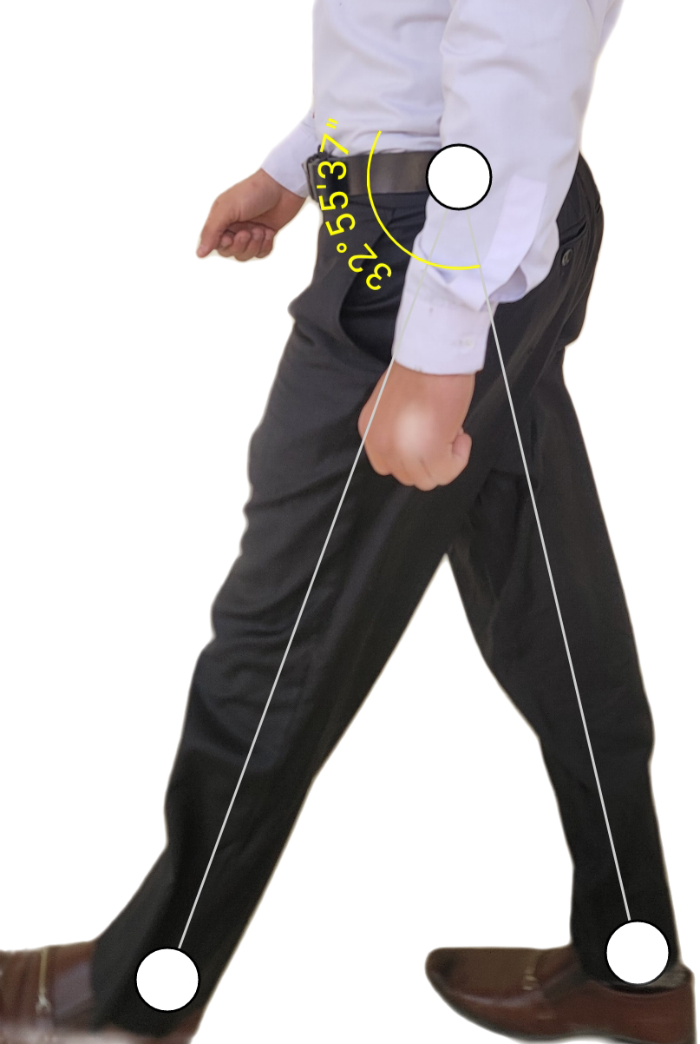
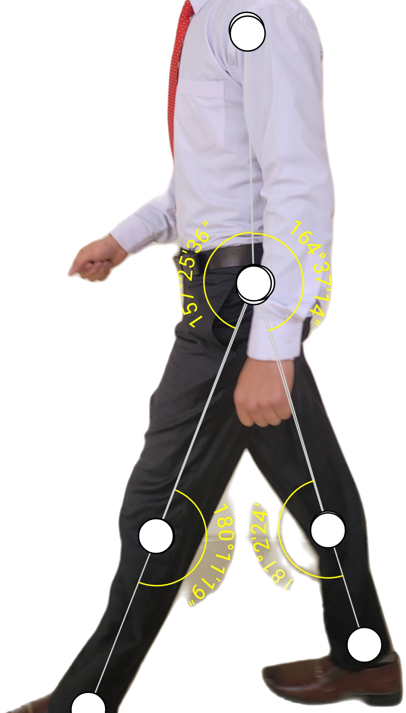
Results
Inertial Measurement Unit (IMU) Testing:
Gyrometer
A gyrometer, also known as a gyroscope or gyro, is a device that measures the rate of rotation around a particular axis.
This graph is plotted on MATLAB by interfacing it with the Arduino IDE. The hardware components I used are an inertial measurement unit (MPU 6050) and an Arduino UNO
CUI, Attock
Innovative wearable robotics for enhancing lower limb mobility and function.

Slide 33
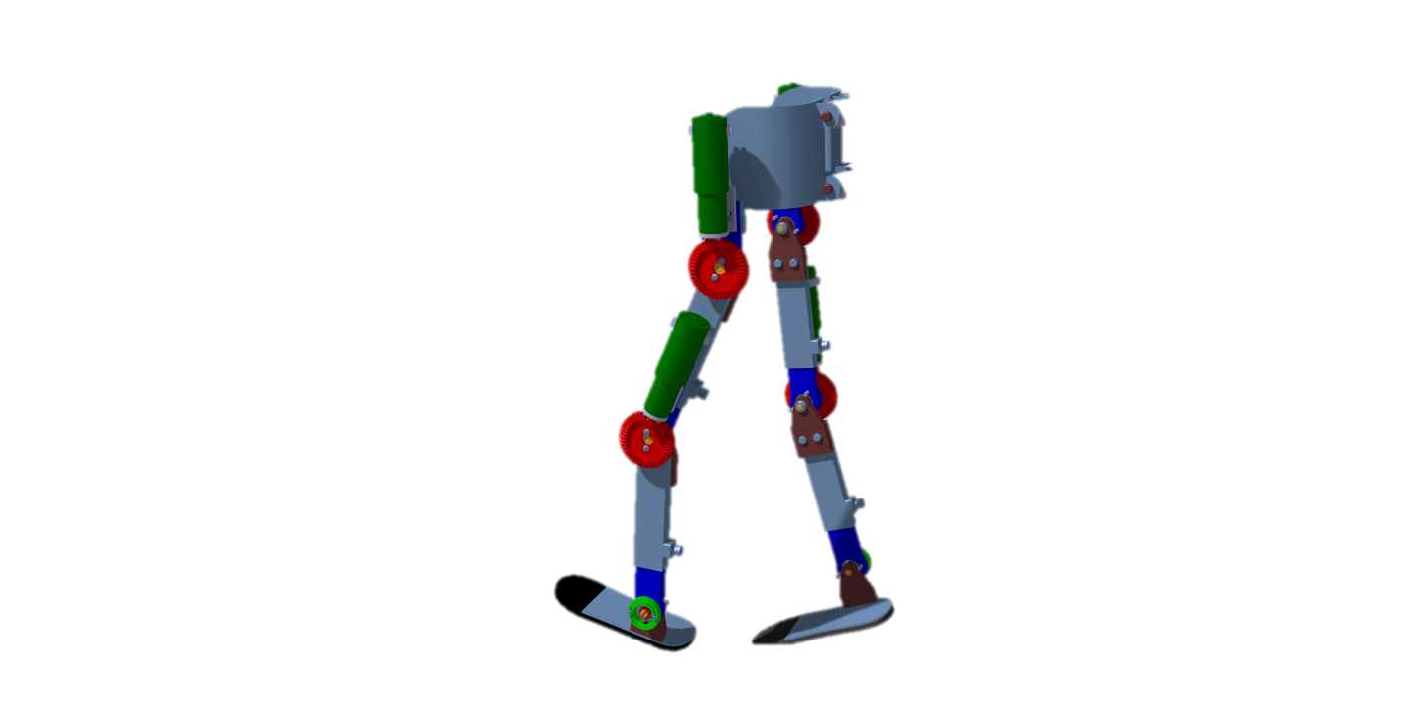
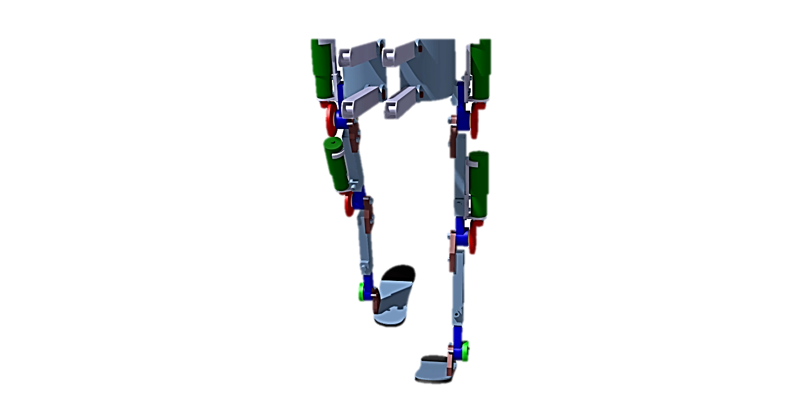
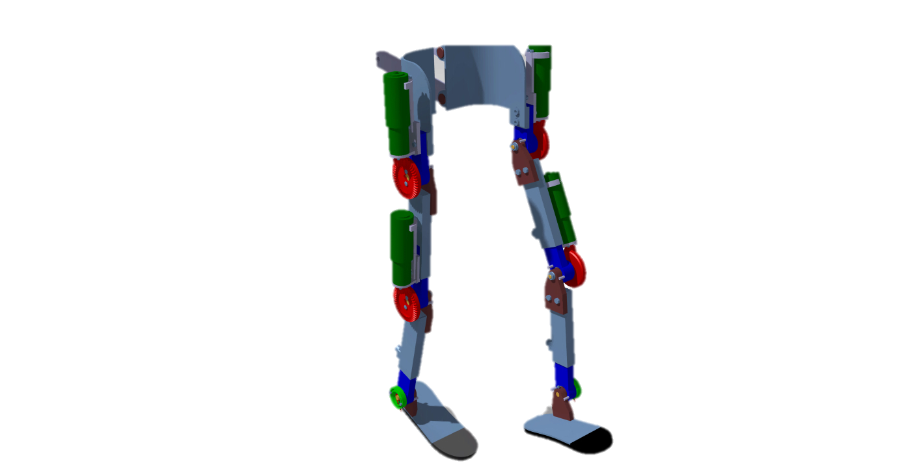
Hip and Knee joints angle while sitting, standing and walking
Sitting Position
Standing Position
Walking Position
Angle b/w legs while walking
CUI, Attock
FYP-Innovative wearable robotics for enhancing lower limb mobility and function.

Slide 34

THANK YOU FOR YOUR ATTENTION
Any Questions
CUI, Attock
FYP-Innovative wearable robotics for enhancing lower limb mobility and function.

